Slide 1



SRI KRISHNA COLLEGE OF ENGINEERING AND TECHNOLOGY
Kuniamuthur, Coimbatore, Tamilnadu, India
An Autonomous Institution, Affiliated to Anna University,
Accredited by NAAC with “A” Grade & Accredited by NBA (CSE, ECE, IT, MECH ,EEE, CIVIL& MCT)
Topic : Linked List - Doubly linked list
www.skcet.ac.in

Slide 2
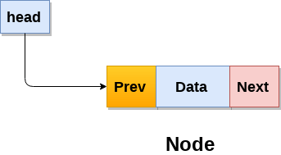
Doubly linked list
Doubly linked list is a complex type of linked list in which a node contains a pointer to the previous as well as the next node in the sequence. Therefore, in a doubly linked list, a node consists of three parts: node data, pointer to the next node in sequence (next pointer) , pointer to the previous node (previous pointer).

Slide 3
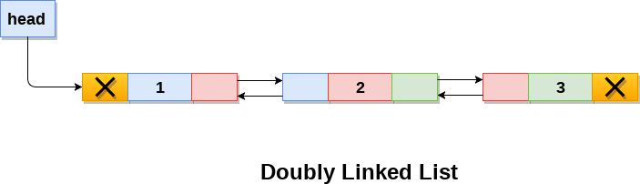
A doubly linked list containing three nodes having numbers from 1 to 3 in their data part

Slide 4
How is it different from a singly linked list?
A doubly linked list allows traversal in both directions. We have the addresses of both the next node and the previous node. So, at any node, we’ll have the freedom to choose between going right or left.
A node comprises three parts, the data, a pointer to the next node, and a pointer to the previous node.
Head node has the pointer to the previous node pointing to NULL.

Slide 5
Creation of Node
struct node
{
int data; // Data
node *prev; // A reference to the previous node
node *next; // A reference to the next node
};

Slide 6
Insertion at Beginning
void Doubly_Linked_List :: add_front(int d)
{
// Creating new node
node *temp;
temp = new node();
temp->data = d;
temp->prev = NULL;
temp->next = front;
// List is empty
if(front == NULL)
end = temp;
else
front->prev = temp;
front = temp;
}

Slide 7
add_before: Adds a new node before another node
void Doubly_Linked_List :: add_before(node *n, int d)
{
node *temp;
temp = new node();
temp->data = d;
temp->next = n;
temp->prev = n->prev;
n->prev = temp;
//if node is to be inserted before first node
if(n->prev == NULL)
front = temp;
}

Slide 8
Adds a new node after another node
void Doubly_Linked_List :: add_after(node *n, int d)
{
node *temp;
temp = new node();
temp->data = d;
temp->prev = n;
temp->next = n->next;
n->next = temp;
//if node is to be inserted after last node
if(n->next == NULL)
end = temp;
}

Slide 9
Adds a new node in the end of list
void Doubly_Linked_List :: add_end(int d)
{
// create new node
node *temp;
temp = new node();
temp->data = d;
temp->prev = end;
temp->next = NULL;
// if list is empty
if(end == NULL)
front = temp;
else
end->next = temp;
end = temp;
}

Slide 10
Delete: Removes the node
void Doubly_Linked_List :: delete_node(node *n)
{
// if node to be deleted is first node of list
if(n->prev == NULL)
{
front = n->next; //the next node will be front of list
front->prev = NULL;
}

Slide 11
// if node to be deleted is last node of list
else if(n->next == NULL)
{
end = n->prev; // the previous node will be last of list
end->next = NULL;
}
else
{
//previous node's next will point to current node's next
n->prev->next = n->next;
//next node's prev will point to current node's prev
n->next->prev = n->prev;
}
//delete node
delete(n);
}

Slide 12
forward_traverse: Traverse the list in forward direction
void Doubly_Linked_List :: forward_traverse()
{
node *trav;
trav = front;
while(trav != NULL)
{
cout<<trav->data<<endl;
trav = trav->next;
}
}

Slide 13
Backward_traverse: Traverse the list in backward direction
void Doubly_Linked_List :: backward_traverse()
{
node *trav;
trav = end;
while(trav != NULL)
{
cout<<trav->data<<endl;
trav = trav->prev;
}
}

Slide 14
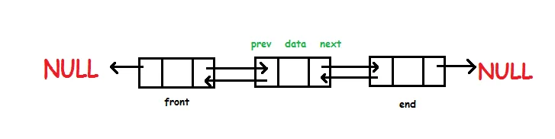
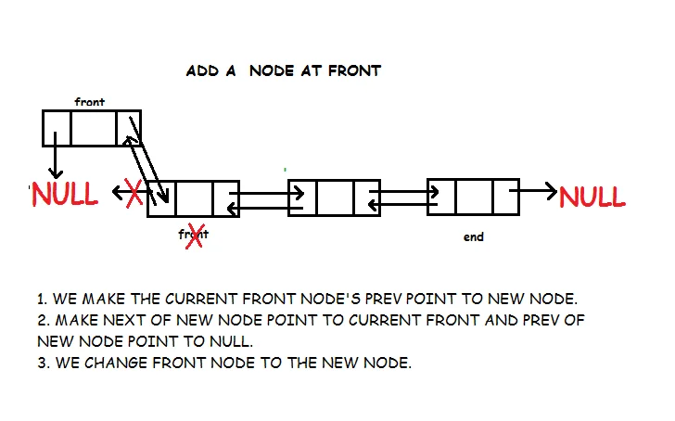
EXAMPLE

Slide 15
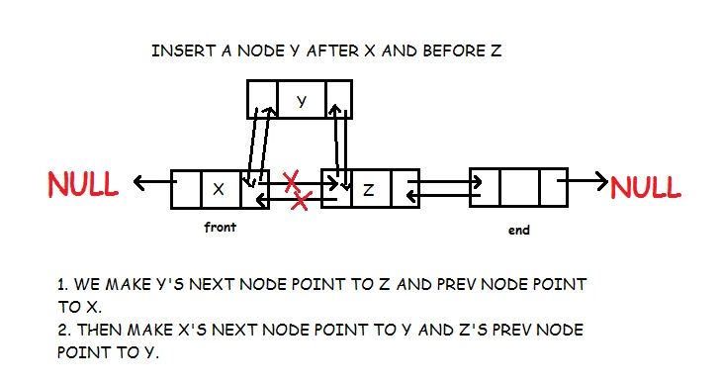

Slide 16
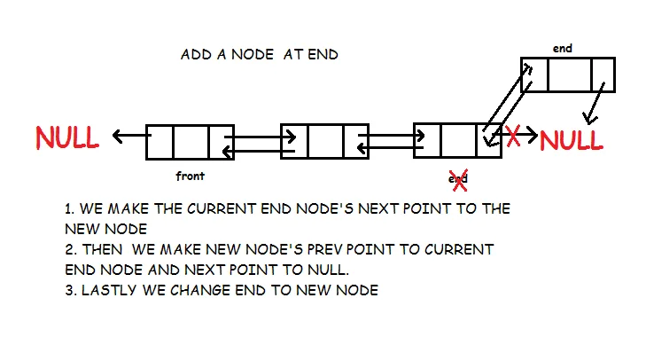

Slide 17
